Slide 1
Assignment 4: Multivariate EDA
Diabetes outpatient records (AIM-94) — Patient 01 case study
Your Name • Course • Date
Notes:
Narration:
This presentation summarizes multivariate exploratory data analysis on the AIM-94 diabetes outpatient records, focusing on Patient 01. I highlight key relationships from the pairs plot, then interpret four additional multivariate comparisons that reveal patterns by day type, time context, and glucose categories.
[Sources]
- ADA Standards of Care overview (2026): https://professional.diabetes.org/standards-of-care
- Standards of Care in Diabetes—2026 (PubMed): https://pubmed.ncbi.nlm.nih.gov/41358900/
[/Sources]

Slide 2
Dataset & variables
AIM-94 outpatient event logs → analysis-ready daily features (Patient 01)
Raw record format (per event)
Daily feature engineering (for multivariate EDA)
Date + time (timestamp)
Code (event type)
Value (BG reading or insulin dose)
Examples in Patient 01: BG (codes 48, 58, 60, 62), insulin (33, 34), symptoms (65)
BG variables: mean per day for each context (pre-breakfast, pre-lunch, pre-supper, unspecified)
Insulin variables: total units per day (regular, NPH)
Symptoms: count per day (hypoglycemia)
Categoricals added: weekend vs weekday, month, day-of-week
Notes:
Narration:
The raw dataset is an event log: each row is a timestamped clinical event. For multivariate analysis, I convert events to a consistent daily level: glucose summaries per context, insulin totals per day, and symptom counts. This makes variables comparable across observations and supports correlation and group-comparison plots.
[Sources]
- AIM-94 Diabetes dataset description (archive README distributed with the dataset).
[/Sources]

Slide 3
EDA plan (Assignment 4 requirements)
Pairs plot + four multivariate comparisons + interpretation
What we produce
Step 1: Pairs plot for all quantitative variables (daily features)
Step 2: Four additional plots (mix of categorical × quantitative and categorical × categorical)
Step 3–5: Interpret patterns; summarize insights and justify visualization choices
Data quality note: missingness is structural
Not every measurement is recorded every day (e.g., pre-lunch BG often missing).
Some relationships may be biased if missingness depends on behavior or routine.
For EDA: use pairwise available data + flag outliers; for modeling: consider multiple imputation or time-series methods.
Notes:
Narration:
Before looking at relationships, I clarify the analysis plan and a key limitation: missingness. In self-monitoring data, gaps are common and often not random, so we interpret correlations cautiously and treat this stage as exploratory. Later, formal approaches like multiple imputation can be used when appropriate.
[Sources]
- van Buuren (2018), Flexible Imputation of Missing Data (2nd ed.): https://www.taylorfrancis.com/books/edit/10.1201/9780429492259/flexible-imputation-missing-data-second-edition-stef-van-buuren
[/Sources]

Slide 4
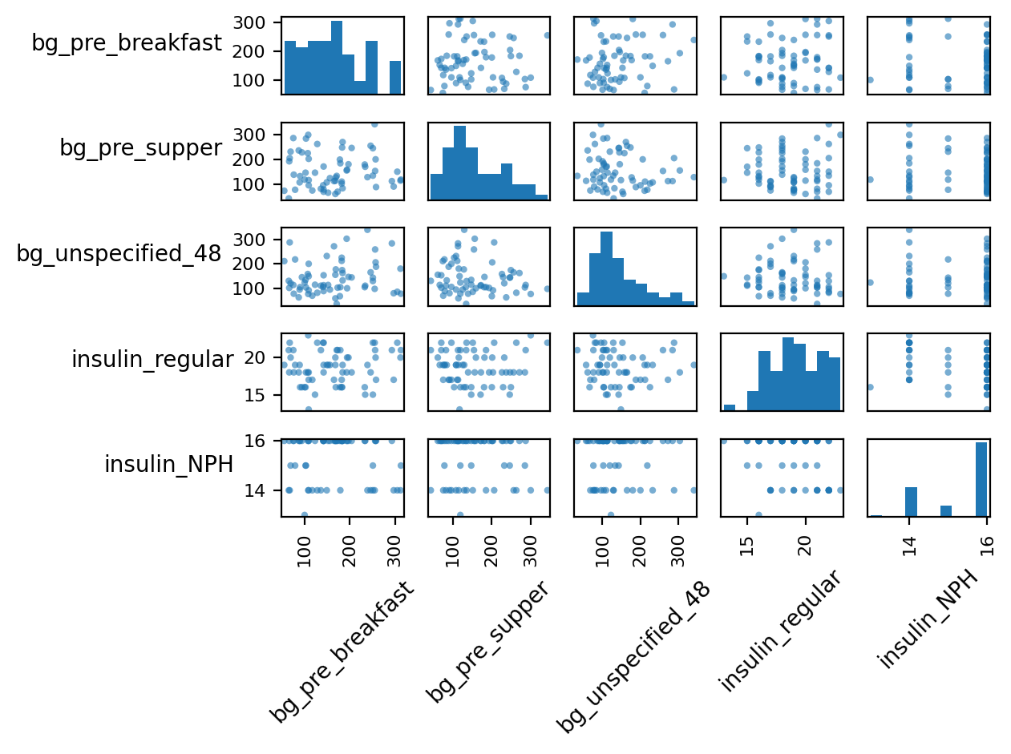
Step 1 — Pairs plot (quantitative variables)
Daily BG contexts, insulin totals, and hypoglycemia symptom counts
How to read
Diagonal: distributions
Off-diagonal: scatterplots
Look for outliers & nonlinearity
Key takeaways (Patient 01)
BG contexts differ in center/spread
Same-day insulin–BG association is weak (feedback + time-lag)
Watch for rare high NPH totals (potential outliers)
Notes:
Narration:
The pairs plot is the fastest way to scan multivariate structure. Diagonal cells show distributions, and off-diagonal cells show pairwise relationships. For Patient 01, glucose distributions differ by context, and same-day insulin totals do not show a strong linear relationship with pre-breakfast glucose—consistent with dosing as a response to glucose and time-lag physiology.
[Sources]
- Tukey (1977) EDA rationale (book citation): https://onlinelibrary.wiley.com/doi/10.1002/bimj.4710230408
[/Sources]

Slide 5
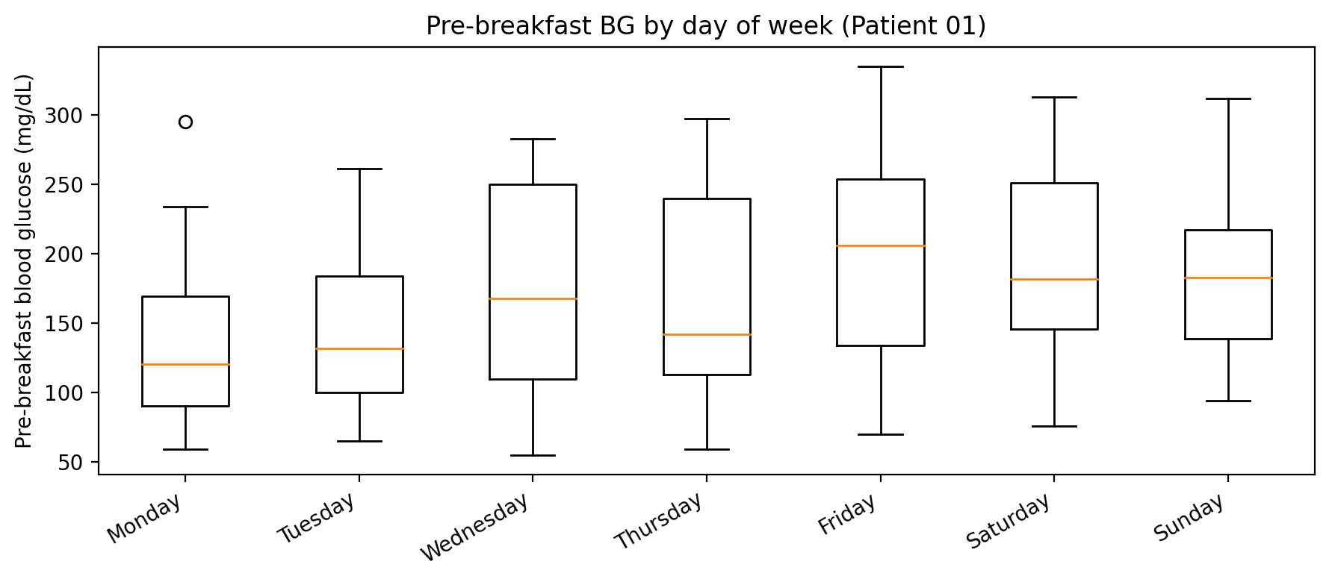
Step 2 — Plot 1: BG by day of week
Categorical (day-of-week) × quantitative (pre-breakfast BG)
Interpretation
Compares central tendency and variability across weekdays/weekends.
Overlapping boxes suggest no large day-of-week effect.
Outliers highlight unusually high or low fasting glucose days.
Notes:
Narration:
This boxplot compares fasting (pre-breakfast) glucose across days of the week. The main EDA goal is to see whether routine differences—like weekend schedules—shift the distribution. Here, the distributions overlap substantially, suggesting no strong day-of-week effect, but outliers still matter clinically and should be investigated.
[Sources]
- General glycemic targets and clinical context: Standards of Care in Diabetes—2026 (PubMed): https://pubmed.ncbi.nlm.nih.gov/41358900/
[/Sources]

Slide 6
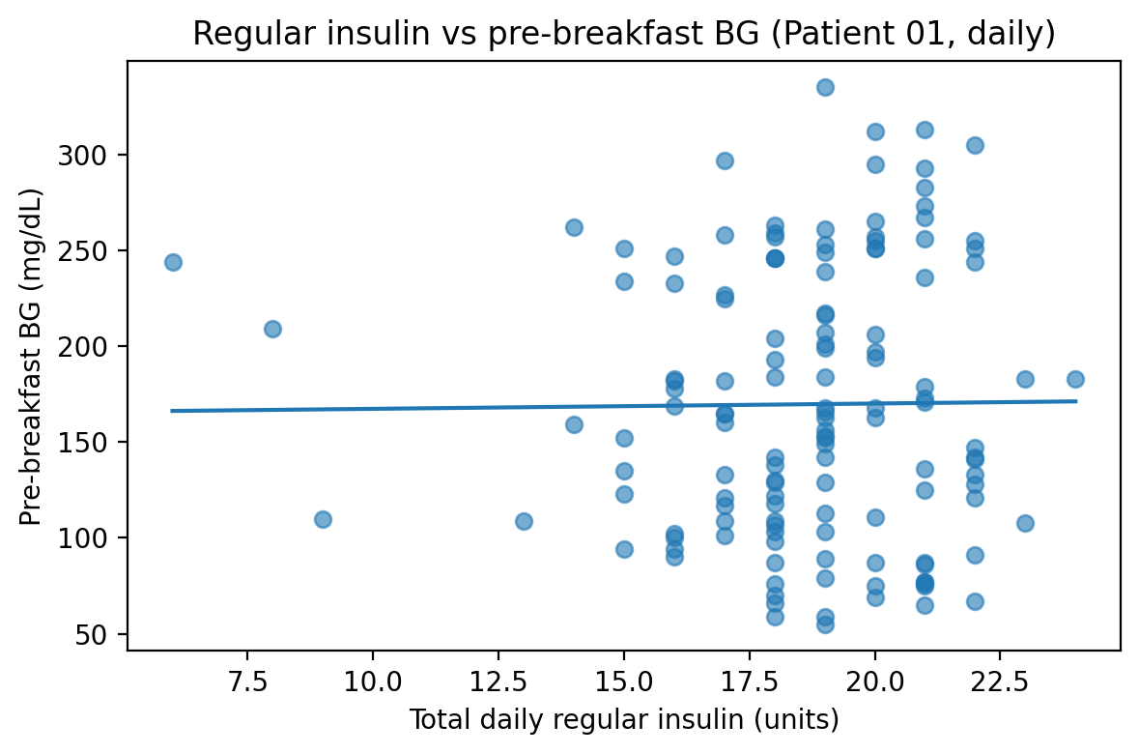
Step 2 — Plot 2: Regular insulin vs fasting BG
Quantitative × quantitative (daily totals vs pre-breakfast BG)
Interpretation
Trend is weak at same-day resolution.
Dosing is typically reactive to glucose; effects may be delayed.
Next step (if modeling): add time-lag features and stratify by context.
Notes:
Narration:
This scatterplot checks whether total daily regular insulin is associated with fasting glucose. The relationship is weak, which is expected in observational diabetes logs: insulin dosing is often a response to glucose values, and the physiological effect may show up later rather than in the same-day fasting reading. In later analysis, time-lag variables and context stratification would be more appropriate.
[Sources]
- DCCT demonstrated benefits of intensive glycemic control (historical context): https://www.nejm.org/doi/full/10.1056/NEJM199309303291410
[/Sources]

Slide 7
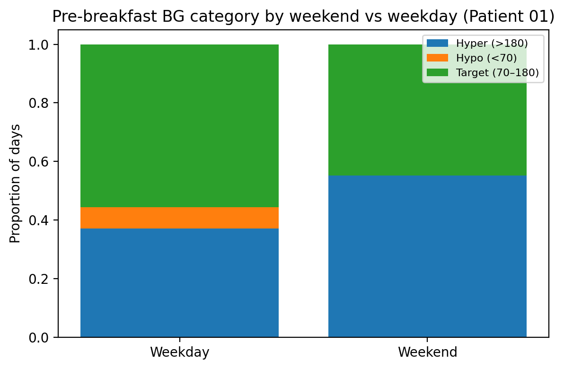
Step 2 — Plot 3: BG categories by weekend
Categorical × categorical (proportions)
Interpretation
Uses a clinically interpretable framing (hypo / target / hyper).
Highlights composition differences even when raw counts differ.
Here: weekends show a higher share of hyperglycemic fasting days (exploratory).
Notes:
Narration:
This stacked percent bar chart compares the *composition* of fasting glucose categories on weekends versus weekdays. Converting a quantitative measure to clinically meaningful categories makes the plot easier to interpret. For Patient 01, weekends appear to have a larger share of hyperglycemic fasting days, but this is exploratory and should be confirmed with larger samples and missingness checks.
[Sources]
- ADA Standards of Care (glycemic targets context): https://professional.diabetes.org/standards-of-care
[/Sources]

Slide 8
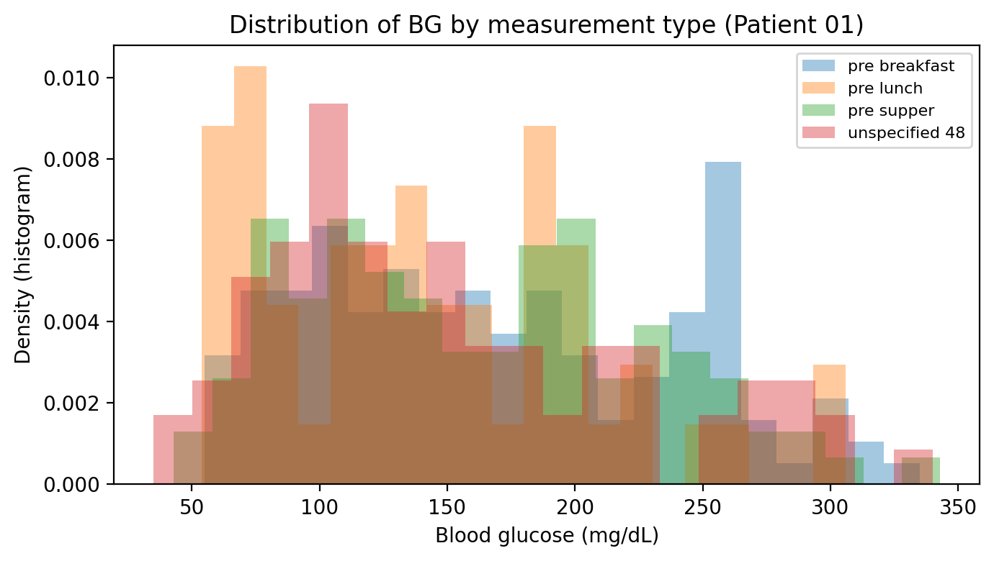
Step 2 — Plot 4: BG distributions by measurement context
Categorical (BG type) × quantitative (BG value)
Interpretation
BG is not one distribution—context matters.
Different centers/spreads reflect physiology + timing of meals/insulin.
Pooling contexts can hide meaningful structure or create misleading averages.
Notes:
Narration:
This density plot shows why multivariate stratification is essential: glucose values differ by measurement context. Fasting readings can have a different center and variability than pre-supper or unspecified readings. If we mix these contexts, we risk masking patterns or drawing incorrect conclusions.
[Sources]
- Tukey (1977) EDA principle of revealing structure through stratification: https://onlinelibrary.wiley.com/doi/10.1002/bimj.4710230408
[/Sources]

Slide 9
Step 4–5 — Why multivariate EDA matters & summary
Key insights and how the visuals support them
Why multivariate visualization matters
Summary of findings (Patient 01)
Reveals conditional structure (subgroups, timing, context).
Makes outliers and logging artifacts visible.
Prevents misleading averages by stratifying key categories.
Guides next modeling steps (lags, transformations, imputation).
BG differs by measurement context (fasting vs other).
Weekend vs weekday composition can shift (more hyper days on weekends, exploratory).
Same-day insulin totals show weak linear links to fasting BG (feedback + time-lag).
Missingness is non-trivial; later work should address it explicitly.
Notes:
Narration:
To wrap up: multivariate EDA helps us see structure that single-variable summaries miss—especially in clinical logs where timing and context matter. In Patient 01, fasting glucose behaves differently than other contexts, weekend composition may differ, and insulin–glucose relationships are not well captured by same-day linear correlation. These findings justify richer features (lags) and careful missing-data handling in any follow-on modeling.
[Sources]
- Tukey (1977) Exploratory Data Analysis (book citation): https://onlinelibrary.wiley.com/doi/10.1002/bimj.4710230408
- van Buuren (2018) Flexible Imputation of Missing Data (2nd ed.): https://www.taylorfrancis.com/books/edit/10.1201/9780429492259/flexible-imputation-missing-data-second-edition-stef-van-buuren
- ADA Standards of Care in Diabetes—2026 (PubMed): https://pubmed.ncbi.nlm.nih.gov/41358900/
[/Sources]

